Slide 1


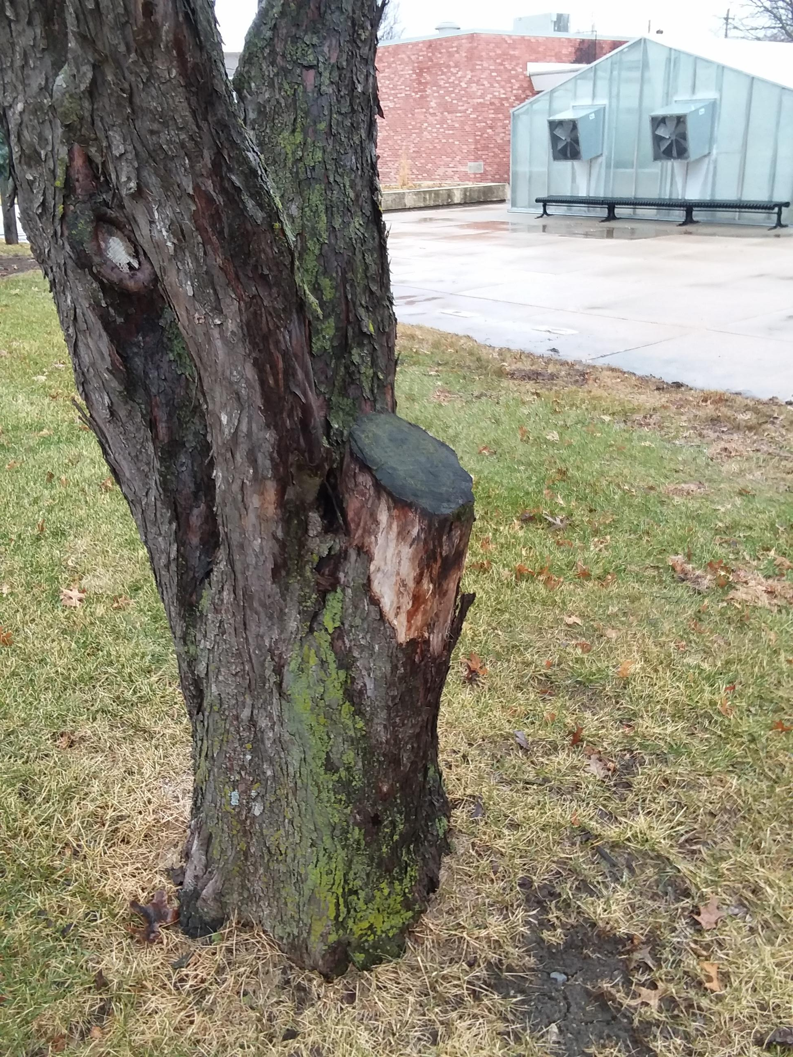
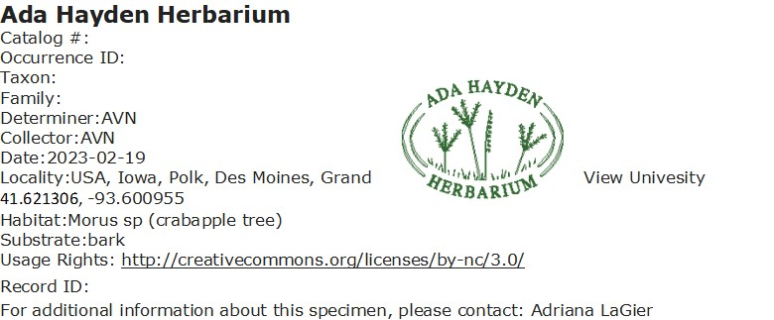
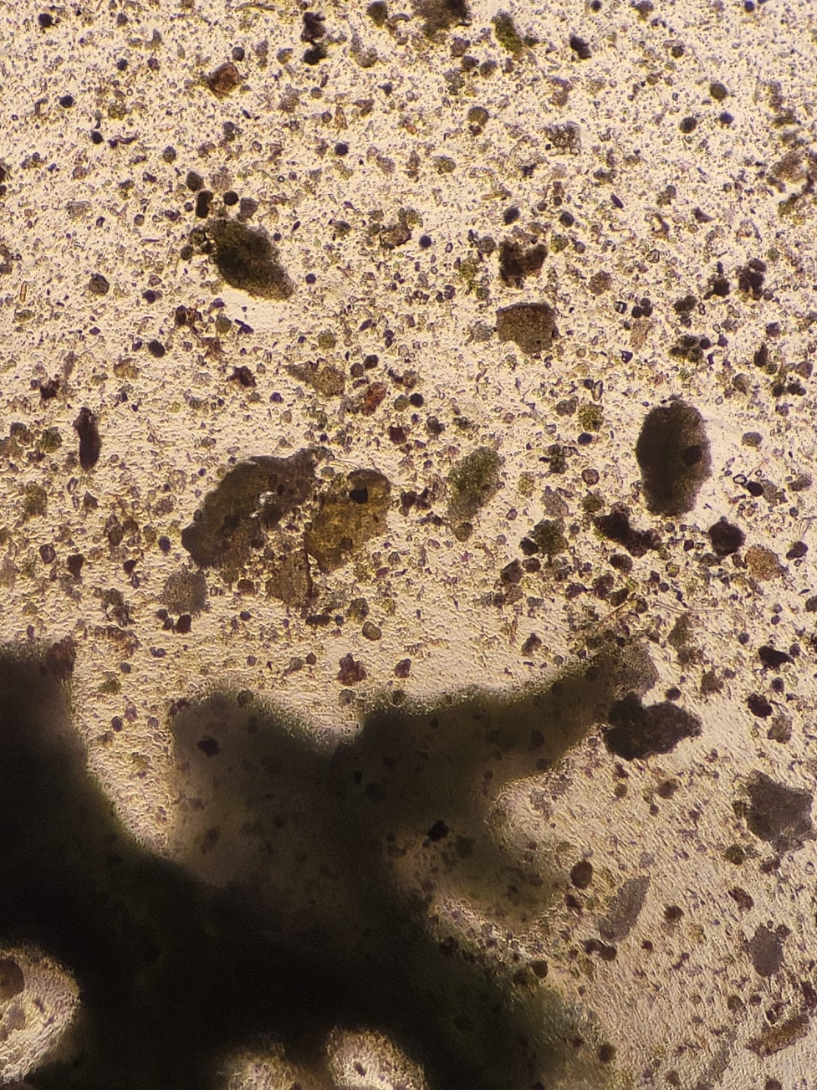
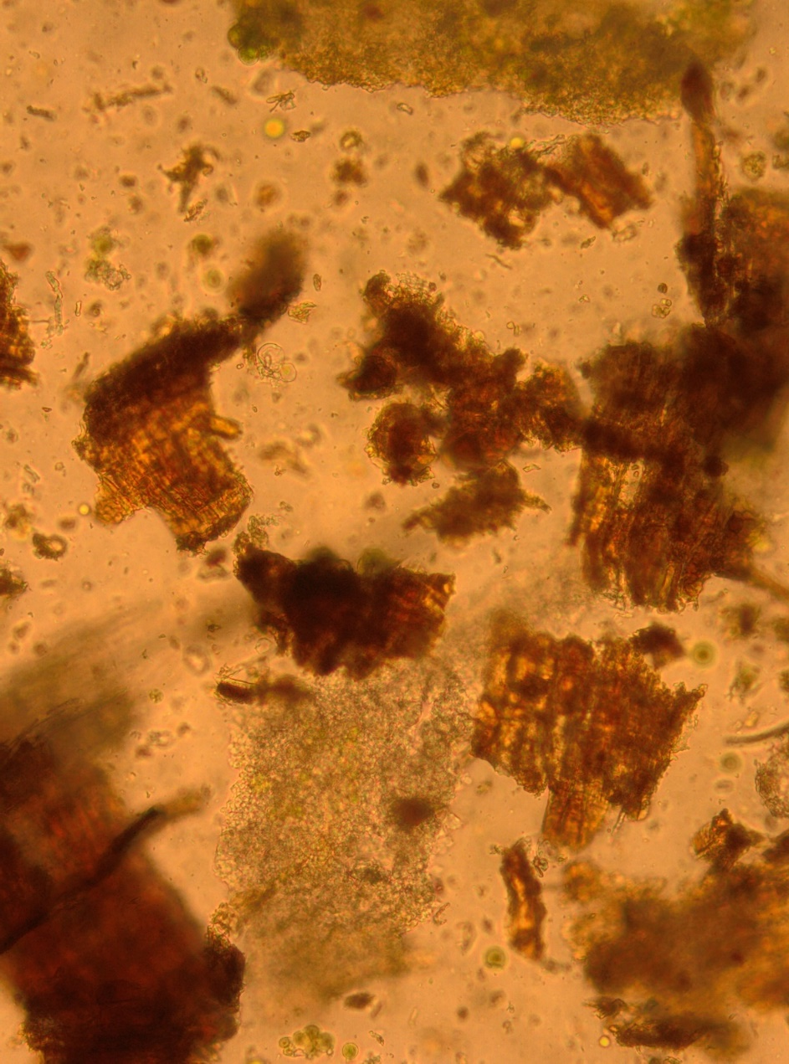
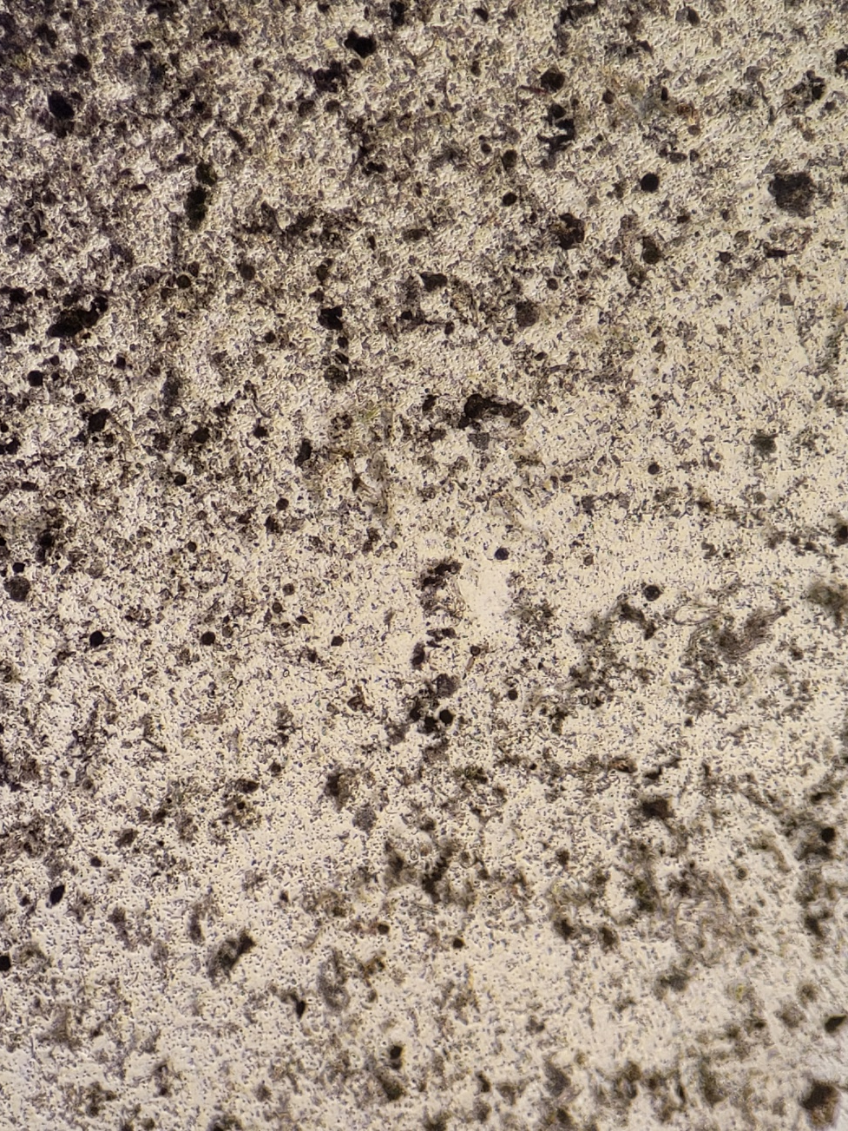
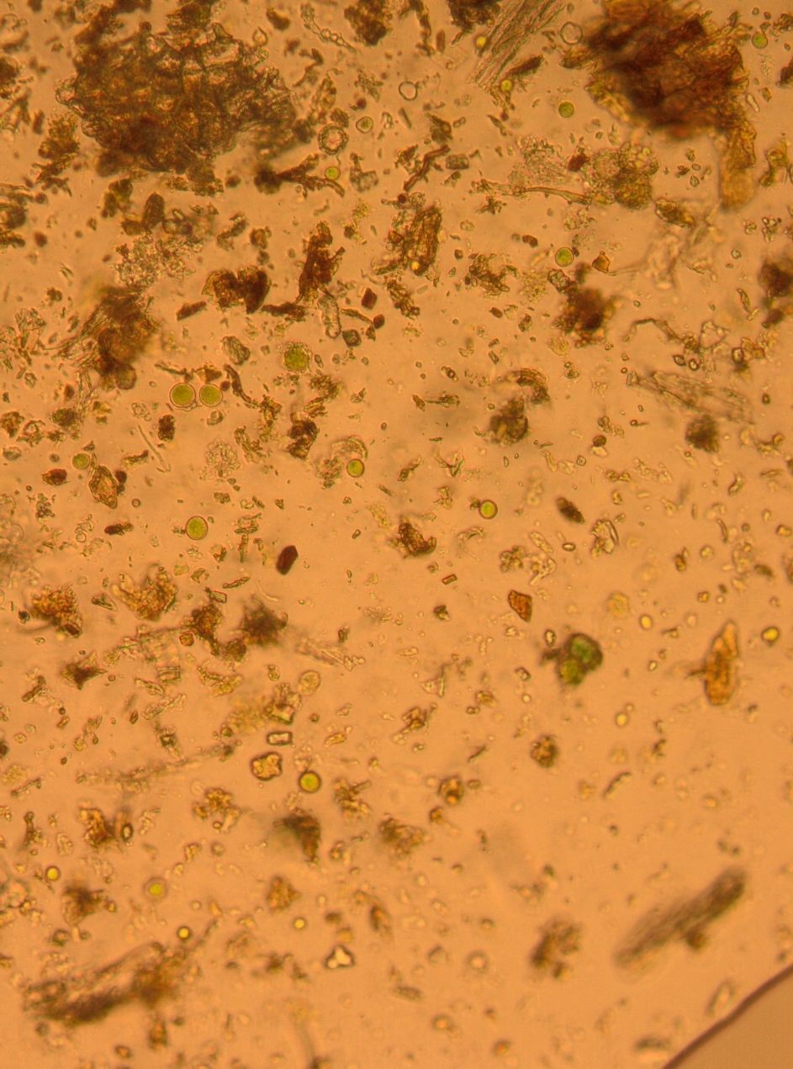
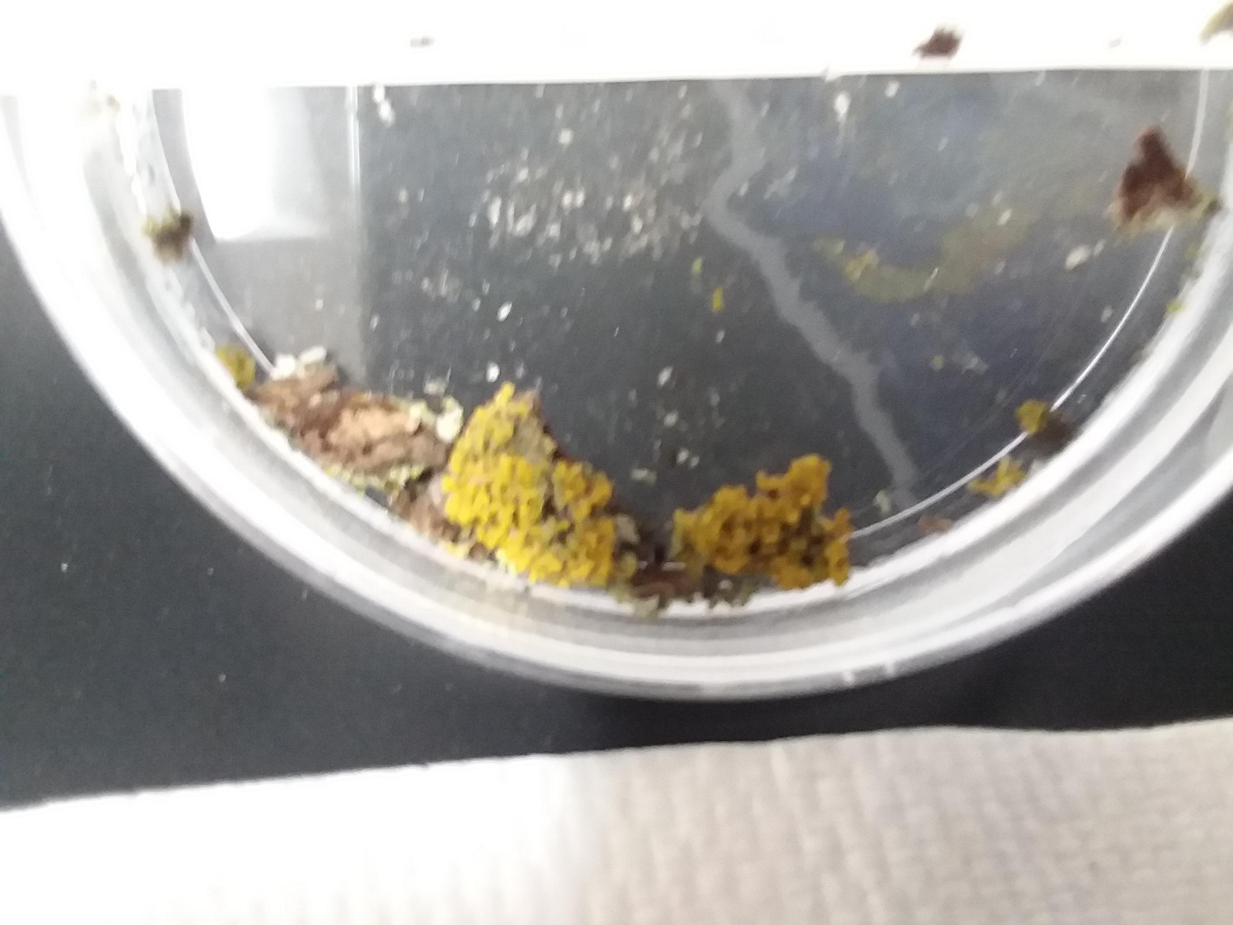
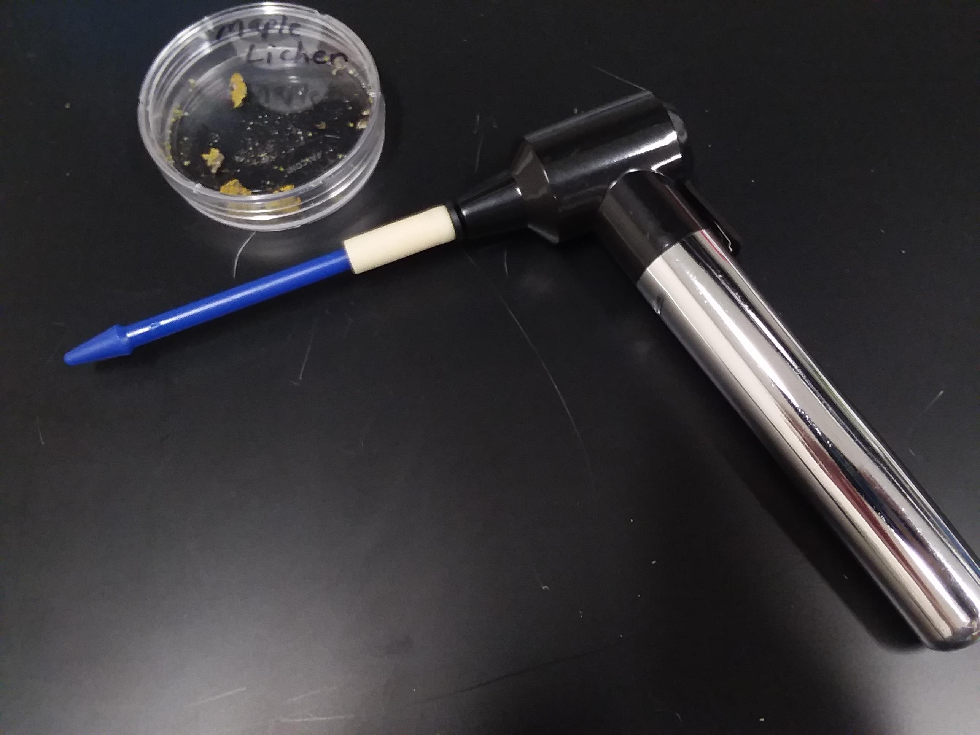
Tracking Lichen Extirpation (local extinction) in Iowan urban areas
Andrew van Nice and Adriana J. LaGier
Grand View University, College of Social and Natural Sciences, Department of Biology, Des Moines, IA 50316
Background
Lichen are symbiotes between fungi and algae or cyanobacteria. They are biosensors of environment health because they are exquisitely sensitive to air pollution in urban areas¹. Local extinction (extirpation) of lichen due to urbanization leads to loss of biodiversity, which is needed for efficient ecosystems.
The Iowa Lichen Project housed in the Ada Hayden Herbarium was established in 1870 to maintain a record of Iowan lichen². Their database is an essential tool for improving understanding of the current, and historical, diversity and distribution of lichens in the state.
Results
Conclusions
We were able to develop a technique to isolate lichen samples for identification.
We are working on creating a record card for submission to the Iowa Lichen Project.
Figure 1
Figure 1: Lichen was collected from three collection sites around Grand View campus. These sites were logged by latitude and longitude using Google maps. Representative picture of lichen collected from “parking lot” site is shown.
Objective
In this study, our main goal was to develop a technique to quickly and efficiently identify the lichen on Grand View University campus.
Our overarching intent is to contribute to the Iowa Lichen Project and track lichen local extinctions in Iowan urban areas.
Figure 2
What to Do Next
We would like to use our isolates to identify the lichen taxon to complete submission record details for the Iowa Lichen Project.
We would like to archive lichen samples.
We would like to extend our collection sites to include more locations so we can track lichen biodiversity on campus.
Figure 2: Micrographs taken of lichen isolations before and after straining. Straining helped separate lichen symbiotes (fungi and cyanobacteria) from each other and from the contaminating bark of the tree that helps with accurate identification.
Lichen Isolate Before Straining
Lichen Isolate After Straining
Materials & Methods
The following is a technique we developed to quickly isolate lichen fungus to efficiently identify the lichen.
Sample. Three trees on campus were identified for the study (see fig1). Bark from each tree, e.g. Morus sp (crabapple). with attached lichen collected with forceps into jar. Sample was kept dry until processed.
Sample Preparation. 0.5 g of sample added to 0.5 mL spring water in 1.5 mL tube. Picture taken.
Sample Homogenization. Sample was homogenized 3 times at one minute intervals using a motorized tissue grinder with attached pestle.
Sample Straining. Homogenate was added to 100 µm nylon cell strainer placed in conical tube. Drop of strained and unstrained sample added to depression slide and pictures were taken.
With Phase Contrast 10x
Without Phase Contrast 10x
With Phase Contrast 10x
Without Phase Contrast 10x
References
1) Abrego, N, et al. 2020. The ISME Journal, 14:2806. https://doi.org/10.1038/s41396-020-0732-1
2) https://www.herbarium.iastate.edu/iowa-lichen-project. The Iowa Lichen Project
Method Figures
Method Figure: Left. Picture of Collected Lichen Sample. Right. Picture of motorized tissue grinder with attached pestle.
Acknowledgments
Grand View University Biology Department for lab support.
Monetary donation by Corteva that helped purchase hand homogenizers.

